Slide 1

BANK CUSTOMER CHURN PREDICTION
التنبؤ بإنهاء تعامل عملاء البنك
Project Review & Milestones 1 & 2
Problem Definition, Dataset Understanding & Data Cleaning Standards
تعريف المشكلة البنكية، فهم البيانات، وعمليات التنظيف والمعالجة
HIBA MUKARUAM MAHMOUD
https://github.com/hibaalshalabi/Bank-Customer-Churn-Prediction.git

Slide 2
Milestone 1 · Part 1
Problem Definition & Dataset Understanding
Project Objectives
Prediction Target
Customer Churn Prediction: Build an accurate predictive model to identify customers likely to leave the bank in advance, enabling proactive retention campaigns and reducing churn rates.
Exited Feature : The target variable is Exited (binary classification 0 and 1), where 0 represents customer retention and 1 represents customer churn or departure.

Slide 3
Milestone 1 · Deliverables
Project Proposal & Technical Proof
01
02
03
Project Proposal
Dataset Exploration
GitHub & Python Proof
Clear business problem description and defined success metrics.
Feature descriptions, target variable identification, and data source.
Initial dataset loading verified via Python and pushed repository.
وصف المشكلة التجارية ومقاييس النجاح.
تحديد المتغير المستهدف ومصدر البيانات.
إثبات التحميل البرمجي ورفع الملفات على جيت هاب.

Slide 4
PROJECT SUCCESS CRITERIA
10,000
Exited
Top 15%
Customer Account Records
Binary Target Variable
High-Risk Churn Isolation
سجلات العملاء الجاهزة للتحليل
متغير التنبؤ الصريح (1 / 0)
استهداف العملاء الأكثر عرضة للمغادرة
14 - Features

Slide 5



MILESTONE BASICS
Why Milestone 2 Matters
أهمية تنظيف وفهم البيانات مسبقاً
01
02
03
Foundation Assumption
Preventing Quiet Errors
Defense & Justification
Every later milestone and machine learning model assumes your dataset is clean and well understood.
A dirty dataset quietly produces wrong statistics, distorted charts, and failing models later on.
Explaining cleaning decisions out loud separates genuine understanding from guesswork.
الأساس لكل النماذج والتحليلات اللاحقة
تجنب الأخطاء الخفية في الإحصائيات
شرح وتبرير القرارات بوضوح تام

Slide 6



Presentation Objectives & Agenda
MILESTONE 2 SCOPE
1. Dataset Architecture
2. Cleaning Justifications
3. Impact & Deliverables
Data dictionary, feature types, and understanding initial customer attributes.
Defending handling of missing values, duplicates, and non-informative features.
Evaluating before-vs-after dataset health and GitHub pipeline deliverables.

Slide 7
Milestone 2 · Metrics
مقارنة البيانات قبل وبعد التنظيف
Before-and-After Cleaning Snapshot
Metric / Feature | Before Cleaning | After Cleaning
Total Dataset Rows | 10,018 | 10,000 (Cleaned)
Missing Values | 550 missing records | 0 missing records
Duplicate Rows | 18 duplicates | 0 duplicates
Account Balance Outliers | Extreme anomalies present | Capped & Handled

Slide 8
Milestone Safeguards
أبرز الأخطاء الشائعة وكيفية تفاديها
Common Pitfalls & How to Avoid Them
Cleaning Without Checking
Treating Outliers as Errors
Missing GitHub Push
Dropping rows blindly before confirming underlying structural issues.
Deleting valid high-value customer balances that carry real insight.
Uncommitted repository work cannot be reviewed or officially graded.
حذف الصفوف عشوائياً بدون فحص دقيق.
اعتبار القيم الشاذة أخطاء برمجية دائماً.
عدم تحديث المستودع على جيت هاب.

Slide 9
MILESTONE 3
BANK CUSTOMER
CHURN PREDICTION
Exploratory Data Analysis, Feature Engineering
and Leakage-Safe Preprocessing Pipeline
تحليل البيانات الاستكشافي، هندسة الخصائص، والمعالجة المسبقة الآمنة من التسريب
Prepared for Demo Session 3
The final checkpoint before model training
DATA → INSIGHTS → PREPARATION
Notes:
بداية العرض: مشروعي هو Bank Customer Churn Prediction. في Milestone 3 ركزت على فهم البيانات من خلال EDA، واستخراج أهم الأنماط، ثم تجهيز البيانات للتعلم الآلي بطريقة تمنع تسرب المعلومات بين التدريب والاختبار. حسب متطلبات هذه المرحلة، لم أقم بتدريب نموذج بعد؛ الهدف أن تكون البيانات جاهزة للنمذجة في المرحلة التالية.

Slide 10
01 / MILESTONE GOAL
What does Milestone 3 demonstrate?
A clear explanation of the findings, preprocessing choices, and evidence that the final data are ready for modeling.
01
02
03
04
Explore
Explain
Prepare
Validate
Visualize churn patterns and compare customer groups.
Translate charts into business insights and interpret correlations carefully.
Engineer useful features and build a complete preprocessing pipeline.
Confirm numeric features, no missing values, and zero train/test overlap.
Milestone 3 is the final data-preparation checkpoint — model training comes next.
BANK CUSTOMER CHURN PREDICTION | MILESTONE 3

Slide 11
02 / DATA OVERVIEW
The starting dataset
Initial data were inspected before any records or columns were removed.
10,018
14
550
18
Rows at import
Features at import
Missing cells
Exact duplicate rows
Raw dataset
Including the target
Across 3 numeric columns
Detected before cleaning
Target variable
Missing values found
Exited = 0
Customer stayed
CreditScore: 200
Exited = 1
Customer exited / churned
Age: 250
EstimatedSalary: 100
BANK CUSTOMER CHURN PREDICTION | MILESTONE 3

Slide 12
03 / DATA CLEANING
What was cleaned — and why
Only exact duplicates and identifier/name columns were removed at the basic-cleaning stage.
Cleaning decisions
After basic cleaning
Removed 18 exact duplicate rows.
10,000
Dropped RowNumber and CustomerId because they are identifiers.
rows retained
Dropped Surname because it is a name field, not a useful modeling feature here.
11
Features remain
Kept missing feature values temporarily; they are imputed after splitting.
Missing values are handled inside the pipeline after train/test split.
BANK CUSTOMER CHURN PREDICTION | MILESTONE 3
Notes:
0

Slide 13
04 / EXPLORATORY DATA ANALYSIS
Questions answered by EDA
Exploration combined summaries, distribution charts, group comparisons, and correlations.
01
02
03
How many customers churn?
Which groups churn more?
How does age relate to churn?
Target count and percentage
Geography, gender, activity, products
Age distribution and age-group rates
04
05
06
Do numeric variables move together?
Does balance status matter descriptively?
What looks useful for preparation?
Correlation matrix and heatmap
Zero vs positive balance
Feature engineering and encoding plan
No rows or columns were removed inside the EDA notebook; data cleaning was handled separately.
BANK CUSTOMER CHURN PREDICTION | MILESTONE 3

Slide 14
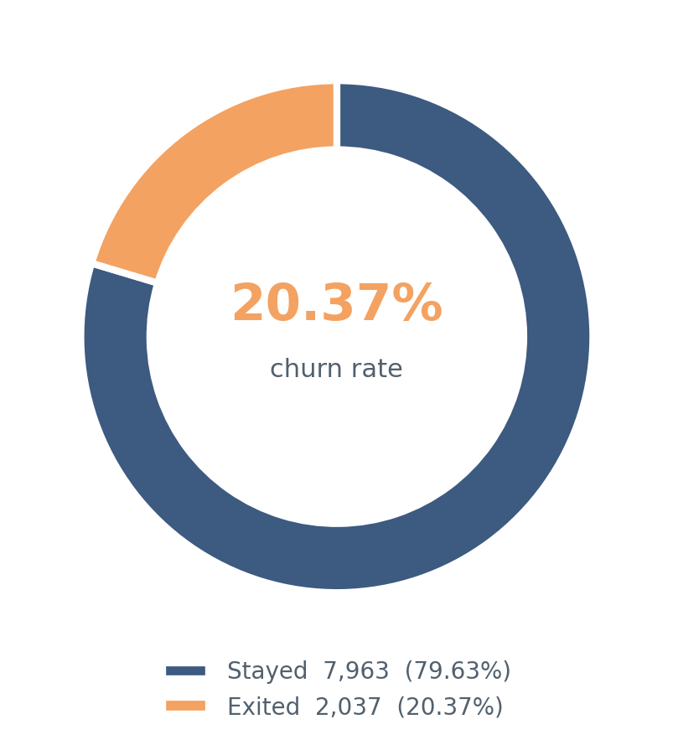
05 / KEY FINDING
About one in five customers churned
After removing exact duplicates, the cleaned analysis set contains 10,000 customers.
2,037
7,963
Customers exited
Customers stayed
20.37%
79.63%
Why it matters
A meaningful minority of customers left, so identifying higher-risk groups can support focused retention efforts.
BANK CUSTOMER CHURN PREDICTION | MILESTONE 3

Slide 15
06 / BUSINESS INSIGHTS
Churn rates vary across customer groups
Observed churn rates after basic cleaning; these are associations, not proof of cause.
GEOGRAPHY
GENDER
ACTIVITY
Germany
32.44%
Female
25.07%
Inactive
26.85%
Spain
16.67%
Male
16.46%
Active
14.27%
France
16.15%
Germany shows the highest rate.
Female customers show a higher observed rate.
Inactive customers show a higher observed rate.
Interpret patterns carefully: differences may relate to multiple variables, not a single cause.
BANK CUSTOMER CHURN PREDICTION | MILESTONE 3

Slide 16
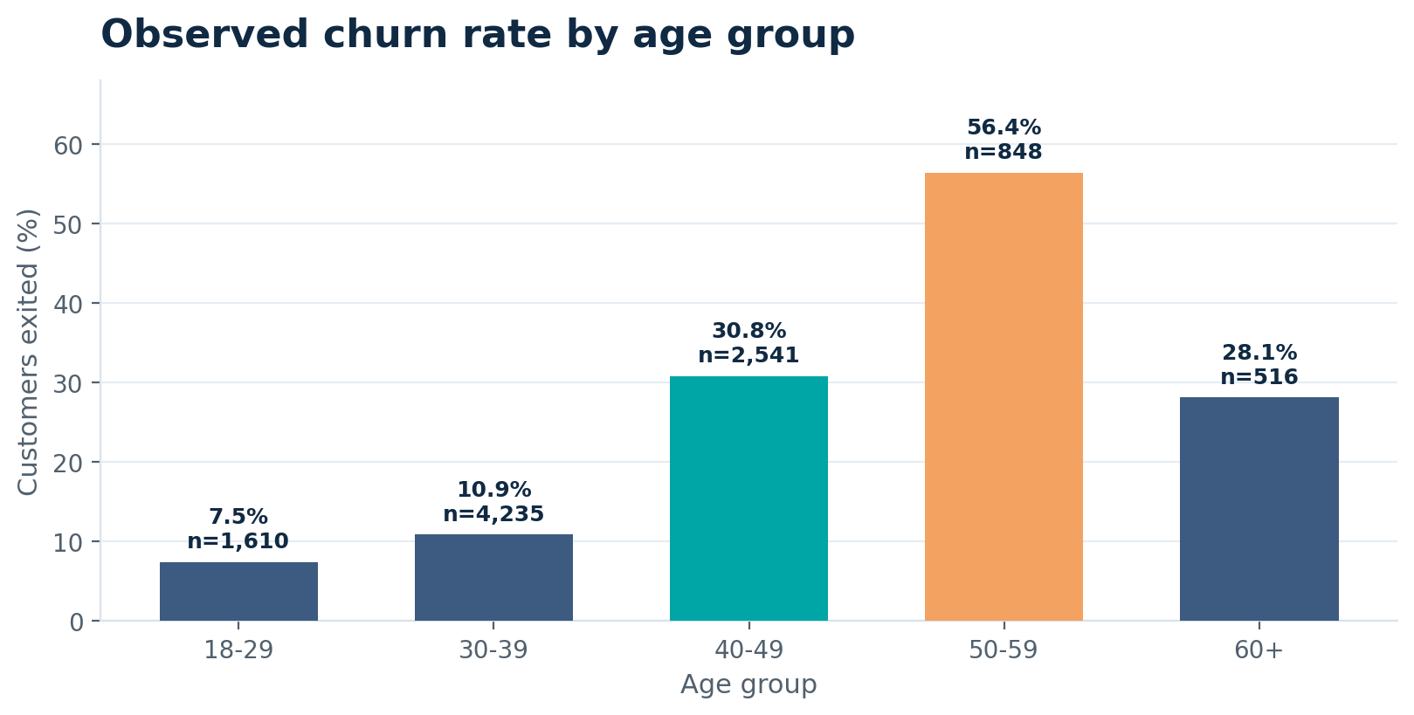
07 / AGE ANALYSIS
Churn is highest among customers aged 50–59
Age groups were created to make age-related patterns easier to compare.
56.37%
Churn rate: age 50–59
848 customers in this group
7.45%
Churn rate: age 18–29
1,610 customers in this group
Observed difference: 48.92 percentage points
BANK CUSTOMER CHURN PREDICTION | MILESTONE 3

Slide 17
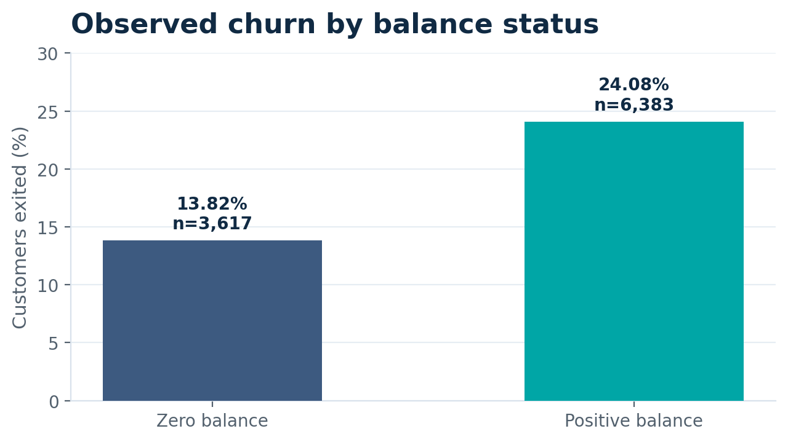
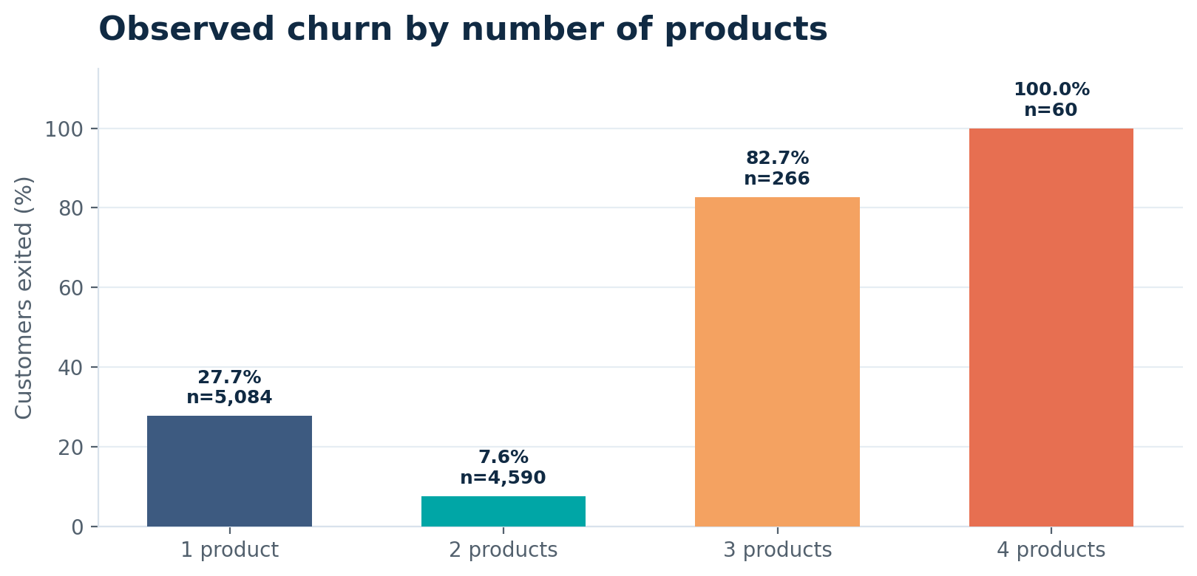
08 / ADDITIONAL SIGNALS
Balance and product count offer more context
Group sizes matter when interpreting very high percentages.
Positive-balance customers showed a higher observed churn rate.
4 products = 100% churn, but only n = 60
BANK CUSTOMER CHURN PREDICTION | MILESTONE 3

Slide 18
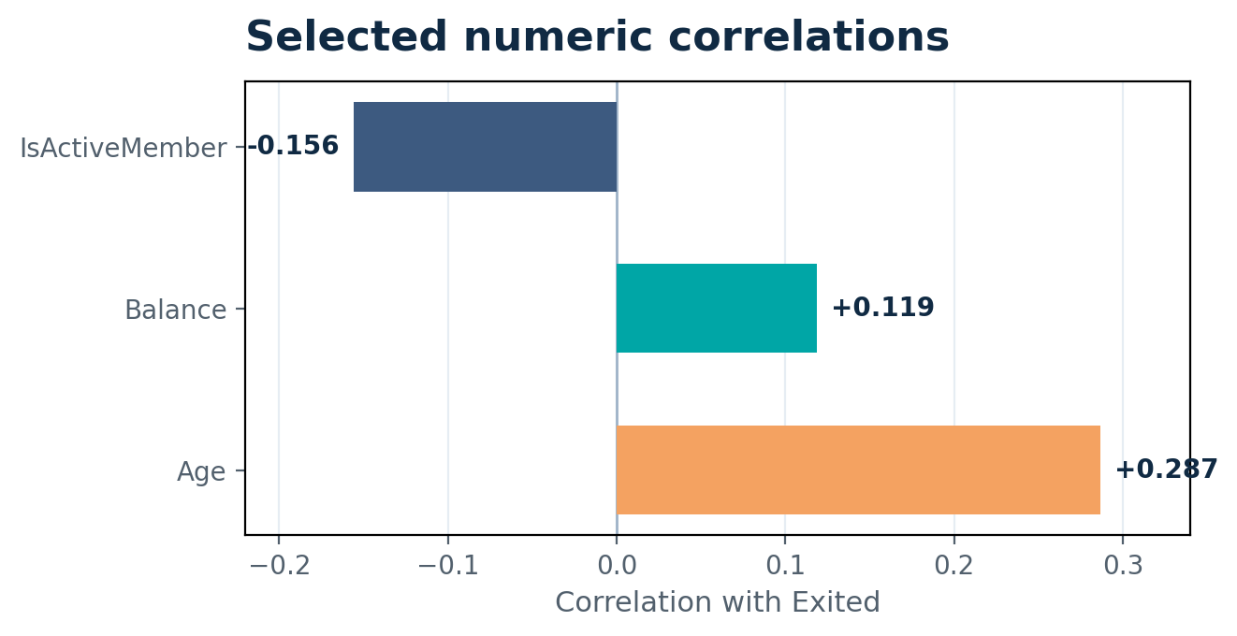
09 / CORRELATION ANALYSIS
Correlation helps describe linear relationships
The heatmap was used to inspect numeric features and their relationship with the target.
Selected correlations with Exited
Age
+0.287
IsActiveMember
-0.156
Balance
+0.119
Correlation ≠ causation
A correlation score does not identify the reason a customer left.
BANK CUSTOMER CHURN PREDICTION | MILESTONE 3

Slide 19
10 / FEATURE ENGINEERING
Two features were created to make patterns more usable
Feature engineering adds a useful representation without changing the target.
NEW FEATURE 01
NEW FEATURE 02
AgeGroup
HasBalance
Convert age into interpretable bands:
Convert Balance into a simple binary flag:
18–29
30–39
40–49
50–59
60+
0 = zero balance
1 = positive balance
Reason: compare churn rates by life-stage-like age groups.
Reason: compare customers by balance status.
AgeGroup is created after filling missing Age values using the training-set median.
BANK CUSTOMER CHURN PREDICTION | MILESTONE 3

Slide 20
11 / PREPROCESSING PIPELINE
The preparation pipeline is explicit and reproducible
The split happens before the pipeline learns imputation, scaling, or encoding values.
01
02
03
04
05
Cleaned data
Train / test split
Feature engineering
Transform features
Model-ready files
10,000 rows
11 columns
80% train
20% test
AgeGroup
HasBalance
Impute + scale
One-hot encode
Train: 8,000 rows
Test: 2,000 rows
Numeric features
Median imputation → StandardScaler
Categorical features
Most-frequent imputation → One-hot encoding
BANK CUSTOMER CHURN PREDICTION | MILESTONE 3

Slide 21
12 / LEAKAGE PREVENTION
How the workflow avoids data leakage
All learned preprocessing values come from the training set only.
TRAINING SET
TEST SET
fit_transform()
transform()
Learns median values for imputation.
Uses the training-set values already learned.
Learns scaling parameters.
Does not refit preprocessing on test data.
Learns categories for one-hot encoding.
Measures future performance more fairly.
Verified: train/test row overlap = 0
BANK CUSTOMER CHURN PREDICTION | MILESTONE 3

Slide 22
13 / READINESS CHECKS
The final data passed the core readiness checks
The exported files are prepared for the next modeling stage.
8,000
2,000
19
0
Training rows
Testing rows
Numeric input features
Missing values remaining
80% of cleaned records
20% of cleaned records
After encoding / scaling
In prepared train/test data
Validation results
Saved outputs
All input features are numeric.
train_model_ready.csv
Train/test overlap count is zero.
test_model_ready.csv
Target Exited remains unscaled.
churn_preprocessing_pipeline.joblib
BANK CUSTOMER CHURN PREDICTION | MILESTONE 3

Slide 23
MILESTONE 3 / CONCLUSION
Explored. Prepared.
Ready for modeling.
Found clear churn patterns across geography, activity, age and product count.
Removed exact duplicates and identifier/name columns.
Created AgeGroup and HasBalance features.
Built a preprocessing pipeline with imputation, scaling and one-hot encoding.
Verified zero train/test overlap and no remaining missing values.
Next step: train and evaluate a machine-learning model in the next milestone.
THANK YOU

Slide 24
PROJECT REVIEW 4 - MILESTONE 4
Bank Customer Churn Prediction
Building on the groundwork of Milestones 1–3 to present machine learning model performance, evaluation metrics, and strategic recommendations for Demo Day.
Status: Milestones 1, 2 & 3 Completed
Current Focus: Milestone 4 & Demo Day Prep
HIBA MUKARUAM MAHMOUD
https://github.com/hibaalshalabi/Bank-Customer-Churn-Prediction.git

Slide 25
PROJECT JOURNEY
Milestones Execution Overview
Milestone 1
Milestone 2
Milestone 3
Milestone 4
Problem & Data Definition
Data Cleaning
EDA & Features
Modeling & Serving
Processed missing fields, duplicate checks, and dropped redundant non-predictive IDs.
Analyzed churn correlations, imbalance ratios, and feature importance indicators.
Pipelines, 5-Fold Stratified CV, export, and Streamlit inference architecture.
Defined target column 'Exited' and verified dataset schema across 10,000 records.
Completed
Completed
Completed
Presenting Now

Slide 26
MILESTONE 4 • PRACTICAL WALKTHROUGH
What this presentation demonstrates
A practical walkthrough of the deployed application
Files used as evidence
• How the app loads the saved Random Forest model and customer dataset
• How Streamlit builds input controls from the dataset's feature columns
• How a submitted customer profile becomes a one-row DataFrame
• How the model returns a class prediction and churn probability
• How the app displays evaluation metrics and a model-comparison chart
• app.py — the actual 729-line Streamlit application
• Churn_Modelling_Featured.cs
Important distinction
• The app loads a previously trained model; training code is not present in the uploaded app.py.
Earlier milestones are not re-presented here; the focus is the working app and its outputs.
TEAM 6 | BANK CUSTOMER CHURN PREDICTION

Slide 27
MODEL ARCHITECTURE
Model Selection & Training Architecture
Logistic Regression
Decision Trees
Random Forest
K-Nearest Neighbors
Interpretable baseline algorithm evaluating linear decision boundaries between churn predictors.
Non-linear rules capturing complex interactions between balance, tenure, and activity level.
Ensemble approach minimizing variance while prioritizing high feature importance signals.
Distance-based clustering approach leveraging customer similarity profiles.
Evaluation Protocol: Stratified 5-Fold Cross-Validation
Selection Metric: Mean CV F1-Score to balance Precision & Recall

Slide 28
MILESTONE 4 • PRACTICAL WALKTHROUGH
End-to-end application flow
01
02
03
04
05
Saved files
Load & validate
Customer form
Prediction
Result
→
→
→
→
best_churn_model.joblib
Churn_Modelling_Featured.csv
Joblib + Pandas
File / target checks
Feature-driven
Streamlit widgets
DataFrame → predict()
→ predict_proba()
Stay / Leave
Churn probability
The application separates the offline training step from online inference: the trained model is saved first, then loaded by Streamlit when users open the app.
Source: app.py — LOAD MODEL AND DATA, PREDICT CHURN sections
TEAM 6 | BANK CUSTOMER CHURN PREDICTION

Slide 29
MILESTONE 4 CODE DEEP DIVE • STEP 1
Preprocessing Pipeline & Data Split Code
# Stratified Train-Test Split (80/20)
X = df.drop(columns=["Exited"])
y = df["Exited"]
X_train, X_test, y_train, y_test = train_test_split(
X, y, test_size=0.20, stratify=y, random_state=42
)
# Column Transformer Pipeline
num_pipe = Pipeline([
('imputer', SimpleImputer(strategy='median')),
('scaler', StandardScaler())
])
cat_pipe = Pipeline([
('imputer', SimpleImputer(strategy='most_frequent')),
('encoder', OneHotEncoder(handle_unknown='ignore'))
])
Stratified Split
8,000 train / 2,000 test rows. Preserves identical churn proportions across sets.
Leak-Free Pipeline
Imputation and scaling parameters are fitted ONLY on training folds.
Technical Insight:
Separated target features and applied ColumnTransformer Pipelines for imputation and encoding to prevent Data Leakage during cross-validation.

Slide 30
MILESTONE 4 CODE DEEP DIVE • STEP 2
Model Comparison & 5-Fold Stratified CV
# Classifiers Dictionary & Stratified Cross Validation
classifiers = {
"Logistic Regression": LogisticRegression(),
"K-Nearest Neighbors": KNeighborsClassifier(),
"Decision Tree": DecisionTreeClassifier(),
"Random Forest": RandomForestClassifier(random_state=42)
}
cv = StratifiedKFold(n_splits=5, shuffle=True, random_state=42)
Model | CV F1 | CV ROC-AUC
Random Forest | 0.5404 | 0.8440
Logistic Reg. | 0.5085 | 0.7804
KNN | 0.4989 | 0.7749
Decision Tree | 0.4867 | 0.6774
Technical Insight:
Trained four baseline classifiers using 5-Fold Stratified Cross-Validation for unbiased performance comparison, identifying Random Forest as the champion (F1: 0.5404).

Slide 31
EVALUATION RESULTS
Fair Cross-Validated Model Comparison
Model Algorithm | CV Accuracy | CV Precision | CV Recall | CV F1-Score | CV ROC-AUC
Random Forest | 85.21% | 73.63% | 42.70% | 0.5404 | 0.8440
Logistic Regression | 72.89% | 40.32% | 68.90% | 0.5085 | 0.7804
K-Nearest Neighbors | 83.42% | 64.91% | 40.55% | 0.4989 | 0.7749
Decision Tree | 79.24% | 49.04% | 48.34% | 0.4867 | 0.6774
Selection Decision: Random Forest achieved the highest mean CV F1-score (0.5404) and ROC-AUC (0.8440), selected as our champion model.

Slide 32
MILESTONE 4 CODE DEEP DIVE • STEP 3
Testing Set Evaluation & Joblib Export
# Evaluate on unseen Test Data & Export Model
best_model.fit(X_train, y_train)
y_pred = best_model.predict(X_test)
y_prob = best_model.predict_proba(X_test)[:, 1]
# Save Artifact for Deployment
joblib.dump(best_model, "best_churn_model.joblib")
Holdout Evaluation Metrics (2,000 Records)
Accuracy
Precision
Recall
85.40%
74.89%
42.51%
Confusion Matrix (2,000 Test Records)
1,535 (TN)
234 (FN - Missed)
58 (FP)
173 (TP - Detected)
Technical Insight:
Evaluated the fitted Random Forest on the unseen test set (2,000 samples) and serialized the model artifact as a .joblib binary for web deployment.

Slide 33
SYSTEM ARCHITECTURE
End-to-End Application Flow
01
02
03
04
05
Saved files
Load & validate
Customer form
Prediction
Result
best_churn_model.joblib & Churn_Modelling_Featured.csv
Joblib + Pandas File / target checks
Feature-driven Streamlit widgets
DataFrame → predict() & predict_proba()
Stay / Leave Churn probability
Architectural Logic: The application separates the offline training step from online inference: the trained model is saved first, then loaded by Streamlit when users open the app.

Slide 34
MILESTONE 4 CODE DEEP DIVE • STEP 4
Streamlit App Implementation (app.py)
# Streamlit Model Loading & Prediction Logic
@st.cache_resource
def load_model(path):
return joblib.load(path)
model = load_model("best_churn_model.joblib")
prediction = model.predict(input_df)[0]
churn_prob = model.predict_proba(input_df)[0][1]
Interactive Web Form
Allows users to input customer attributes and get real-time predictions.
Live Cloud Deployment
Deployed via Streamlit Community Cloud for continuous online evaluation.
Technical Insight:
Built an interactive web interface using Streamlit, leveraging resource caching to load the Joblib artifact once and return instant real-time churn predictions.

Slide 35
PREPARATION FOR DEMO DAY
Project Challenges & Planned Fixes
Identified Limitations
Action List before Demo Day
Class Imbalance: Affects standalone Recall for churned class (234 missed churners).
Feedback Integration: Incorporate section-by-section notes from today's Milestone 4 review.
Decision Cutoff: Currently set at default 0.50 probability cutoff.
Threshold Tuning: Adjust decision threshold to prioritize higher Recall for high-risk churners.

Slide 36
DEMO & WEB APPLICATION
Experience the live application for predicting bank customer churn.
Streamlit Web App
Open the deployed application
Click the link to open the app, then enter customer data to view the prediction result and churn probability.
https://bank-customer-churn-prediction-atalpbeoaf97cyeksxxx9s.streamlit.app/

Slide 37


Thank You & Questions
HIBA MAHMOUD (Team 6)
Ready for Milestone Evaluation & Team Q&A Session
شكراً لحسن استماعكم · جاهزون لاستقبال الأسئلة والملاحظات

